Slide 1


Exploring Professional Development on
Rachele Low │ Customer Training Specialist
rlow@ebsco.com│ +61 0429 106 099

Slide 2

Rachele Low
EBSCO Training Specialist for Oceania
Background in Midwifery, Education, and Library and Information Studies
Registered Midwife

Slide 3
Objectives
By the end of today’s session, participants will be able to:
Describe the features of Nursing Reference Center Plus
Navigate Nursing Reference Center Plus
Understand various material types in Nursing Reference Center Plus
Access CE Modules to build CPD credits

Slide 4

What is it?
Nursing Reference Center Plus (NRC Plus), is a web-based nursing reference system designed to provide the latest evidence-based clinical information for nursing practice, education, management, and research at the point of care, including more unique content, such as images & videos

Slide 5
Are your familiar with CINAHL?
CINAHL stands for:
Cumulative Index to Nursing and Allied Health Literature.
CINAHL databases are…
The most widely-used and respected research tools for nurses, students and allied health professionals
Peer-reviewed
Evidence-based
Unmatched in coverage with over 3.4 million records
Did you know…
Nursing Reference Center Plus is created by the same world-class team of nurses, allied health professionals and librarians as the CINAHL databases
Nursing Reference Center Plus meets the same high standards for evidence-based nursing practice that anyone familiar with CINAHL is accustom to

Slide 6
Nursing Reference Center Plus Evidence-Based Methodology
1
Identify the Evidence
2
Select the Best
3
Critically Appraise
4
Objectively Report
5
Synthesize the Evidence
6
Report Conclusions and Make Recommendations
7
Adjust Conclusions When New Evidence is Published

Slide 7
Search mode: Boolean
AND is used between terms to narrow your search
  - smoking AND cancer will retrieve references containing both search terms
OR is used between terms to broaden your search
  - smoking OR cancer will retrieve references containing either search term
NOT is used to omit a term from your search
  - nausea NOT chemotherapy will retrieve references containing the term nausea, but that do not contain the term chemotherapy

Slide 8
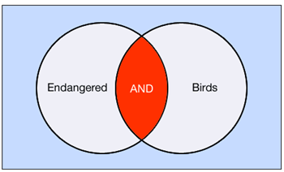
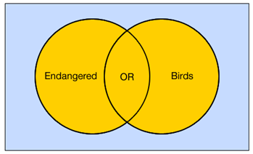
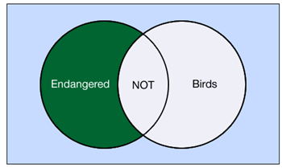
Search mode: Boolean
AND OR NOT

Slide 9
Search Tips
The truncation/word stemming device is the asterisk (*)
- diabet* will retrieve diabetes, diabetic, etc.
The single character wildcard is question mark (?)
- wom?n will retrieve woman or women
The no or multiple character wildcard is the hash (#)
- colo#r will retrieve color or colour
Use quotation marks for “phrase searching”
  - “pressure ulcer:” will retrieve references that contain the terms next to each other in this exact order

Slide 10


Live Demonstration

Slide 11
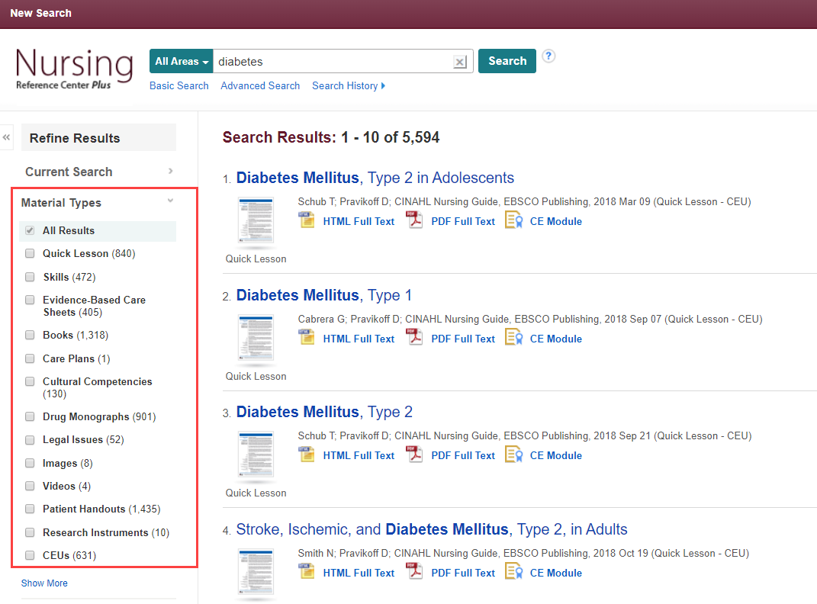
Material types in NRCP
The ‘Material Types’ limiter will provide you with direct access to various document one is looking for.

Slide 12
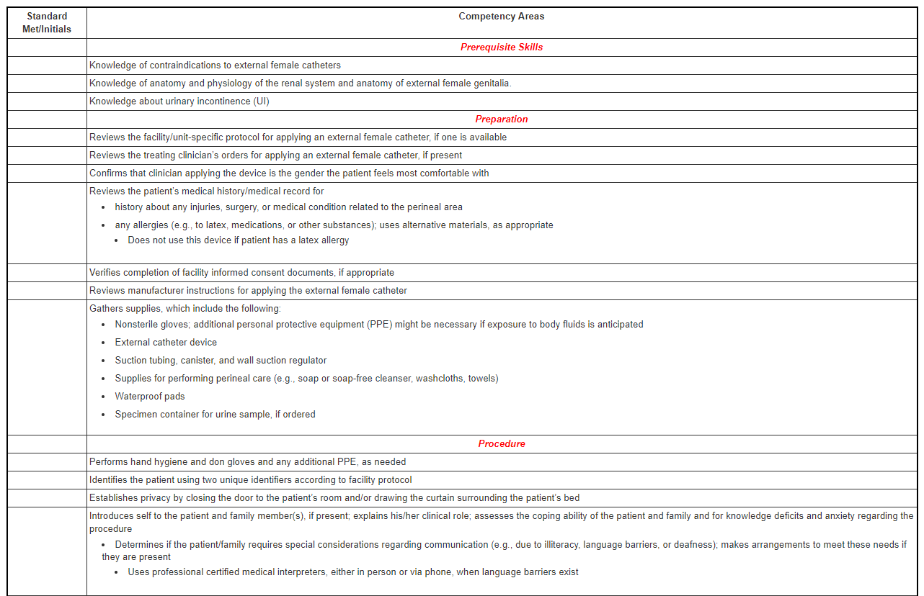
Skill Competency Checklist
Skill Competency Checklist includes prerequisite skills, preparation, procedure and post procedural responsibilities information.
Interactive Skill Competency Checklist only includes procedure information.

Slide 13
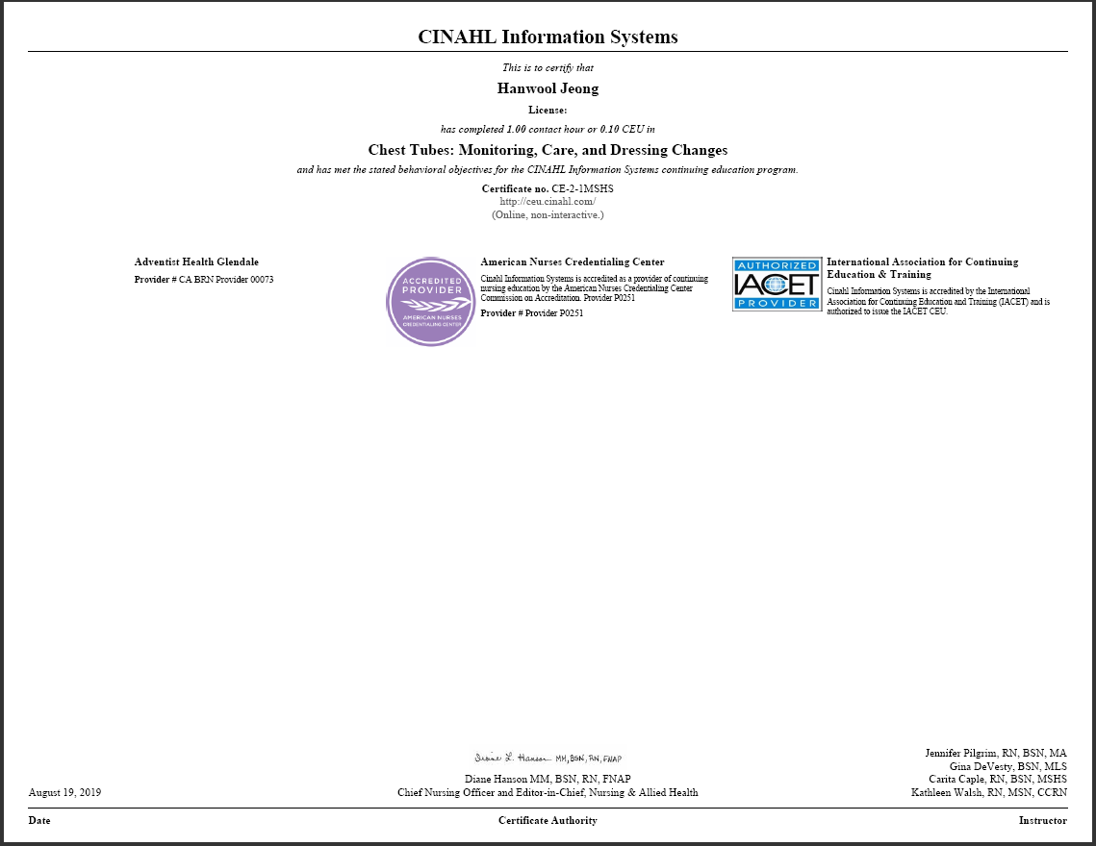
Continuing Education Modules
More than 2800 CE Modules are available in NRCP through CINAHL Education.
Certificates are automatically generated to those who had passed the test.

Slide 14
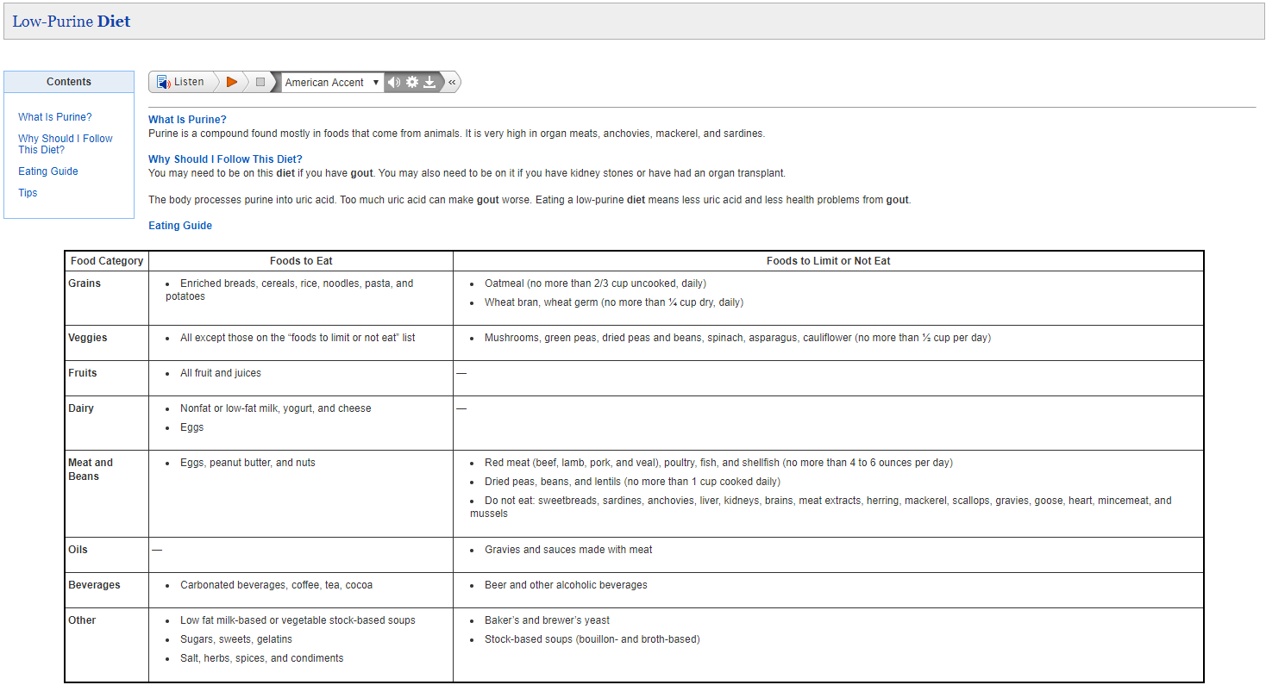
Patient Education (Handouts)
Patient handouts can be easily printed to share with patients or patient’s family to provide further information.

Slide 15

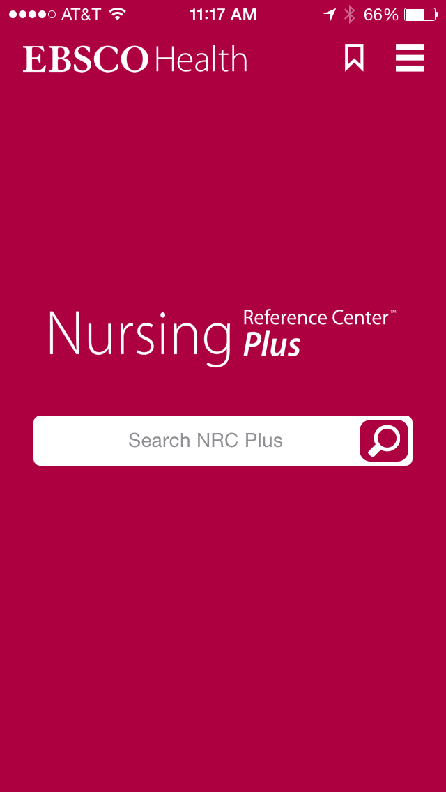
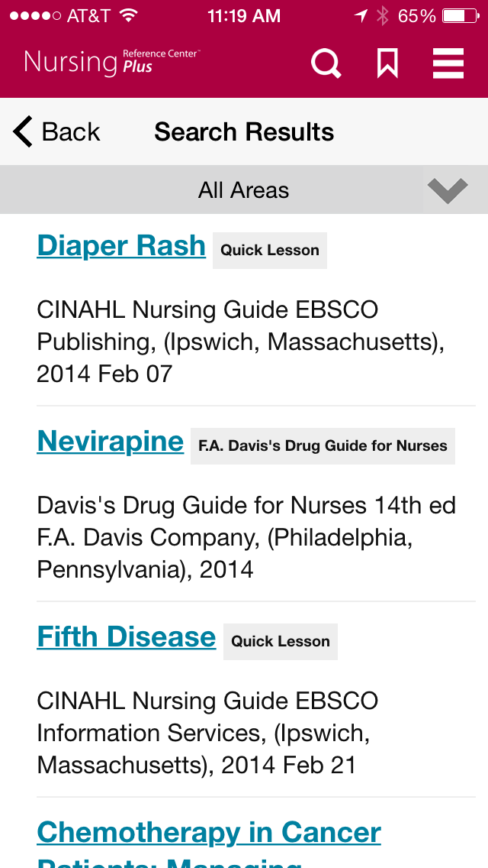
Complimentary mobile app gives user access to NRC Plus anywhere they go!
Notes:
15

Slide 16

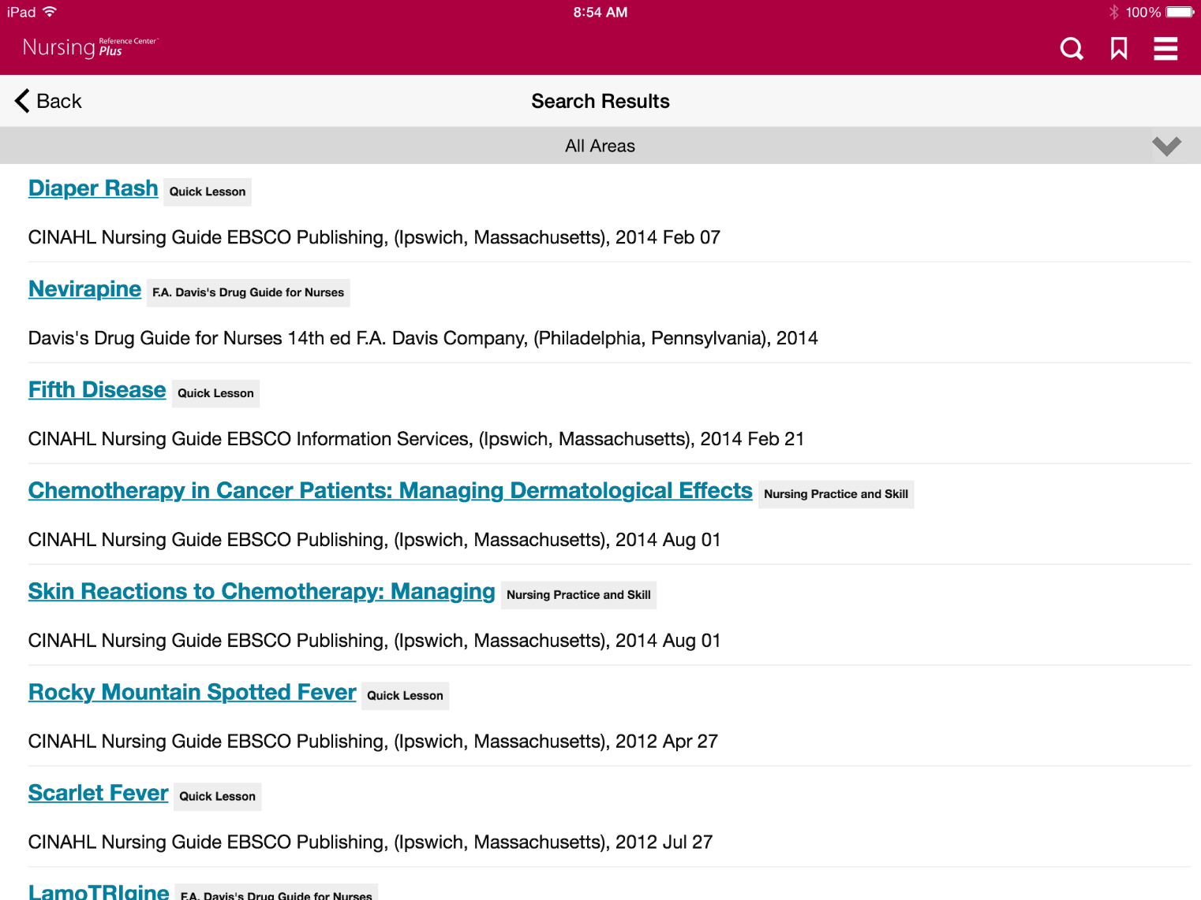
Mobile
(tablet view)

Slide 17
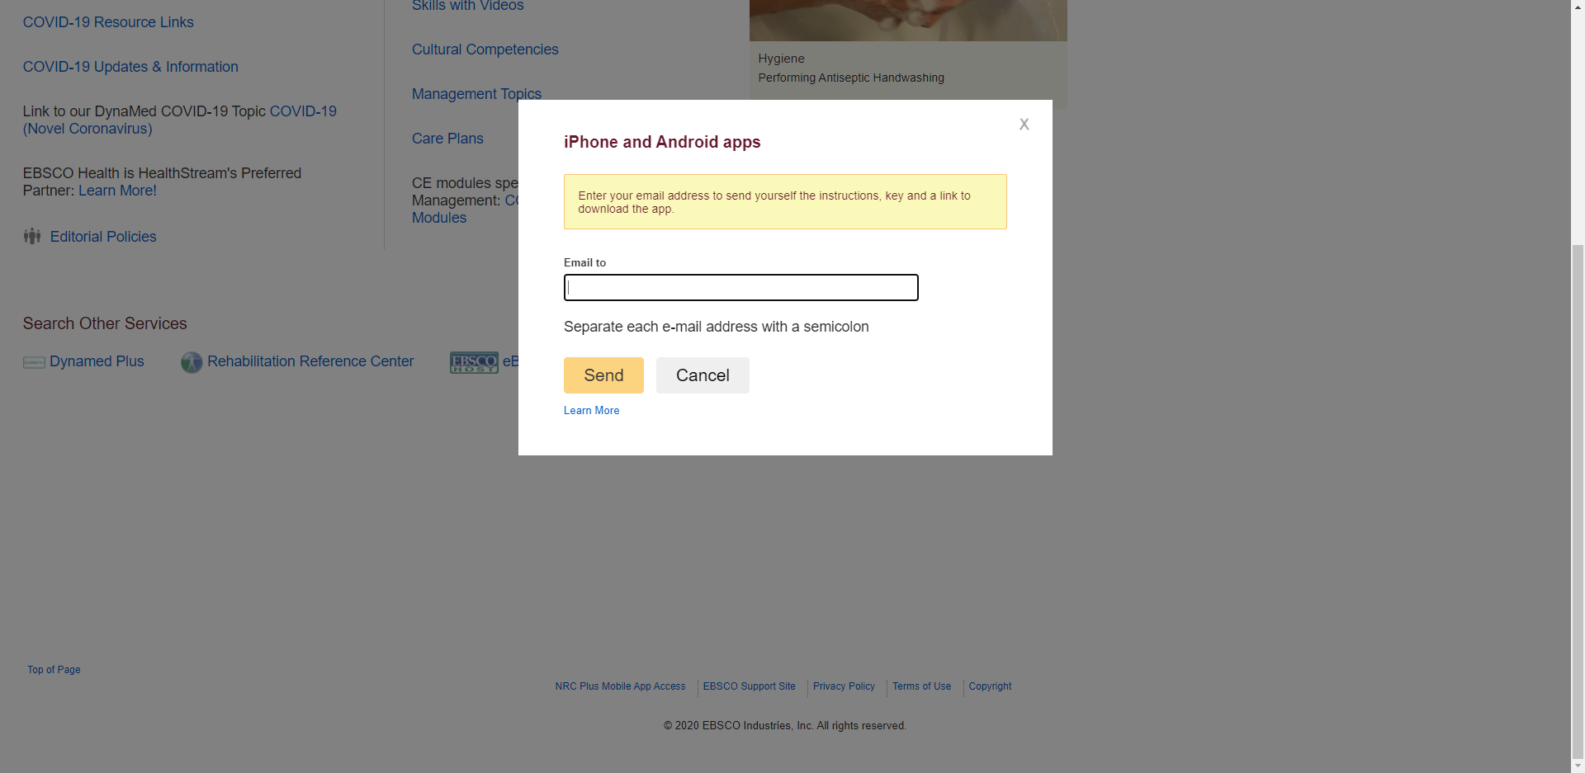

Slide 18

Questions?

Slide 19
Thank you!
Rachele Low │ Customer Training Specialist Oceania
rlow@ebsco.com
+61 0429 106 099

