Slide 1
Presentation Title
Ramsay Health Care Library

Slide 2
Registration
The Ramsay Library is at www.ramsaylibrary.com.au
On a Ramsay networked device you don’t need a logon.
When outside the Ramsay network you need a personal Athens logon.

Slide 3
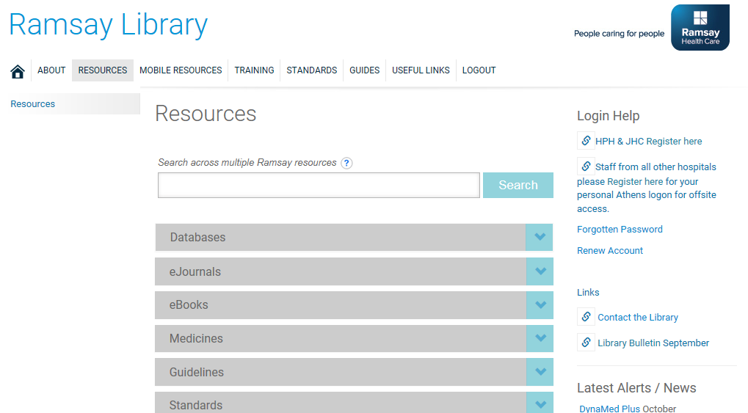
Registration
Library Registration form when on a Ramsay computer

Slide 4
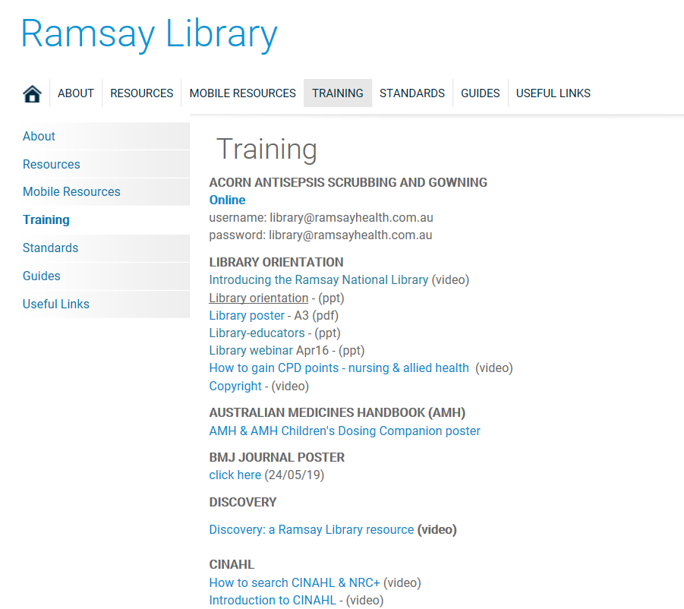
Training Tab

Slide 5
Ramsay Library Resources
Available to all staff at www.ramsaylibrary.com.au
Onsite and offsite access
Resources include point of care, research databases, ejournals and ebooks
There is a Helpdesk service at:
library@ramsayhealth.com.au : 07 3394 6750

Slide 6
Copyright
Q. Can you make a copy of an article that is part of the RHC Library journal collection? If so, how many copies?
Yes, one copy for your personal use
Q. Can you make multiple copies of articles for the purpose of training Ramsay staff?
No, unless you have permission from the supplier/author

Slide 7
Copyright
Q. How can you share journal articles that are included in the Library collection?
Use links to the article
(in policies/procedures and training)

Slide 8
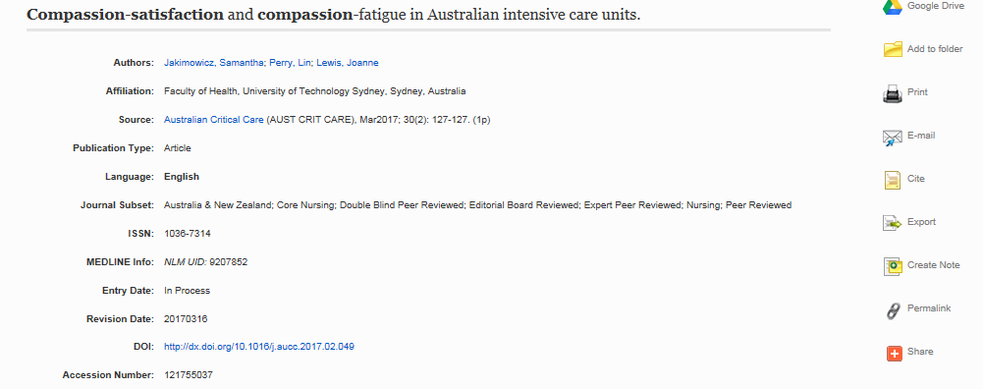
CINAHL

Slide 9
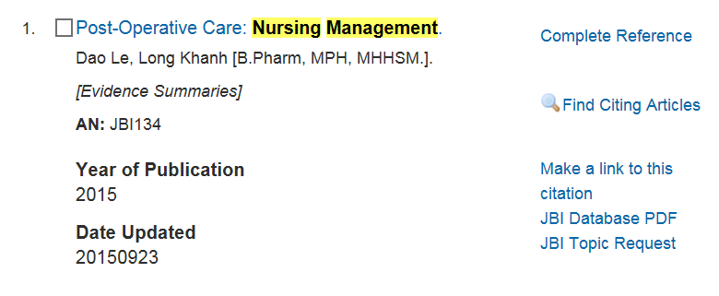
Joanna Briggs Institute

Slide 10
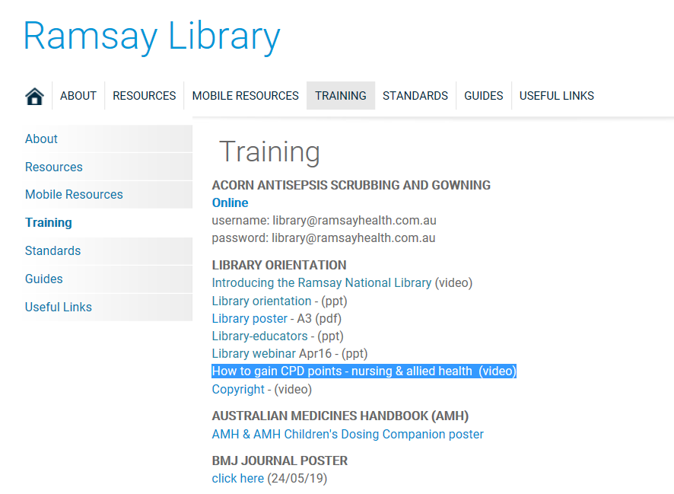
How to gain CPD points

Slide 11
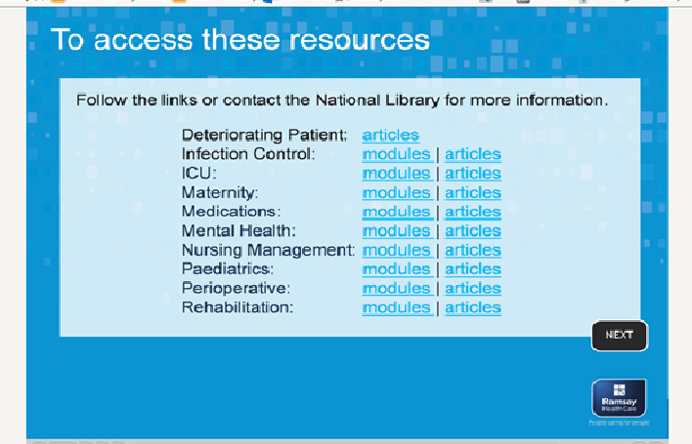
In the video How to gain CPD points …

Slide 12
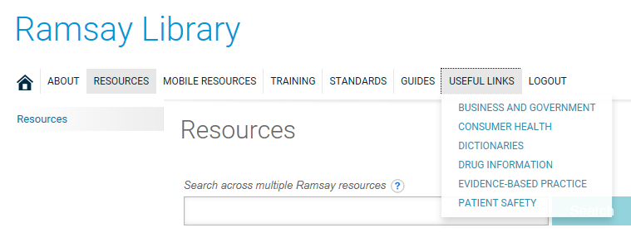

Slide 13
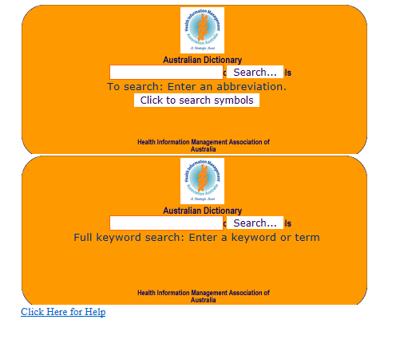
HIMAA Dictionary

Slide 14
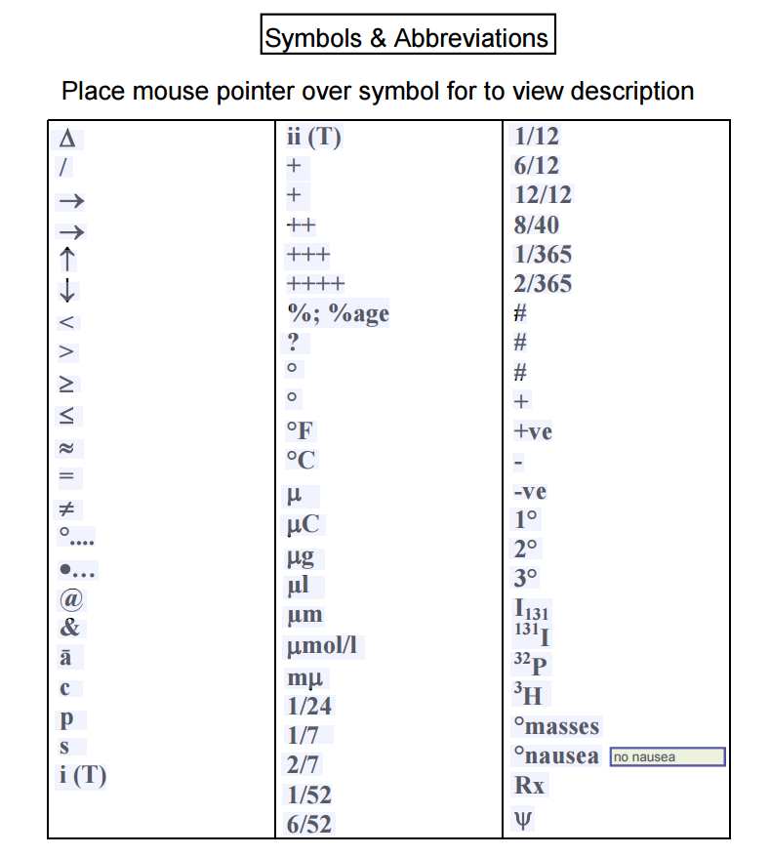
HIMAA Dictionary

Slide 15

ACORN PERIOPERATIVE STANDARDS
ACORN PERIOPERATIVE STANDARDS
Linked to the Ramsay Home page and Library sites, and at: https://www.webdoxx.com/acorn/acorn15/index.php No logon is required. Access is only available onsite.

Slide 16
Helpdesk
library@ramsayhealth.com.au
07 3394 6750

