Slide 1
Ramsay National Library
Medical

Slide 2
National Library Website and Resource Access
The Ramsay National Library is at https://www.ramsaylibrary.com.au
On a Ramsay networked device you don’t need a logon.
When outside the Ramsay network (IP range) you need a personal Athens logon.
The JHC and HPH Library Registration Form is at: https://ramsayhealth.intersearch.com.au/cgi-bin/koha/ramsayselfreg.pl
For all other hospitals, you need to be on the Ramsay network, or have a Ramsay email address, and submit the Library Registration Form at: https://register.openathens.net/ramsayhealth.com.au/register

Slide 3
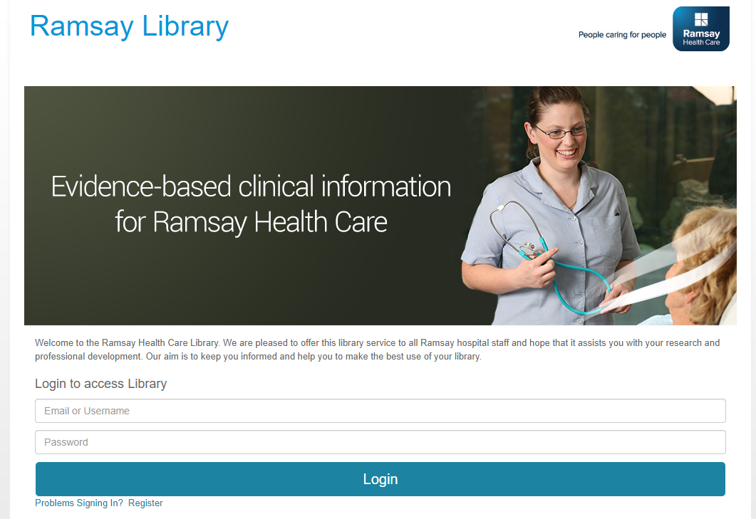
https://www.ramsaylibrary.com.au

Slide 4
RESOURCES
AMH AND CDC - accessible only when on the Ramsay network
DYNAMED
MIMS (WITH DON’T RUSH TO CRUSH)
THERAPEUTIC GUIDELINES
RESEARCH DATABASES
EBSCO EBOOK COLLECTIONS – Go to MEDICAL RESEARCH DATABASES and select eBook Medical Collection or eBook Psychology, Psychiatry Collection. Typing in FT Y will bring up the full list. Or, you may like to Search, for example, on the word Psychiatry and limit to Subject (SU).
OVID: EBOOK PAGE
JOURNAL INDEX

Slide 5
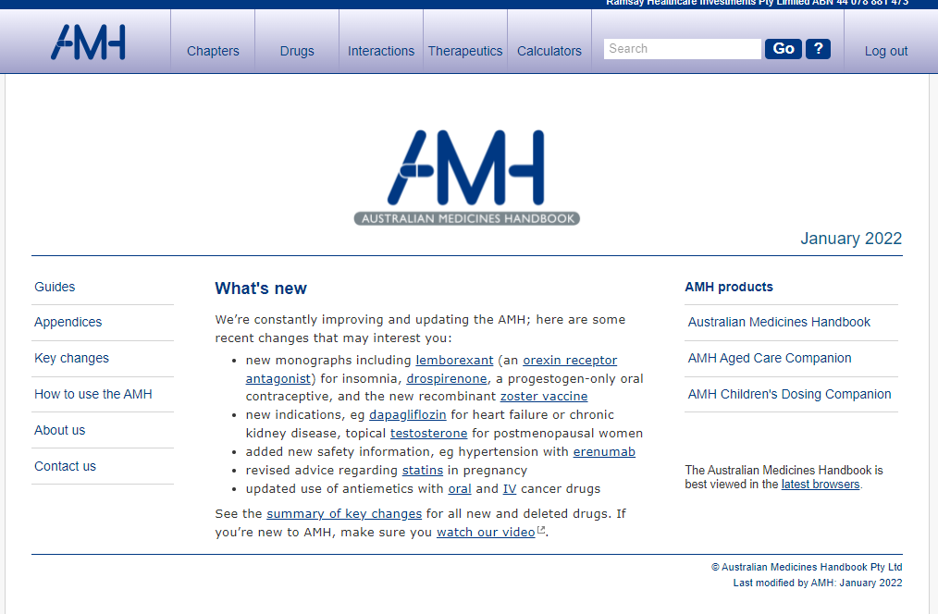
Australian Medicines Handbook (AMH): monographs, class statements, therapeutic information: https://amhonline.amh.net.au/
Links through to the AMH Children's Dosing Companion
onsite only

Slide 6
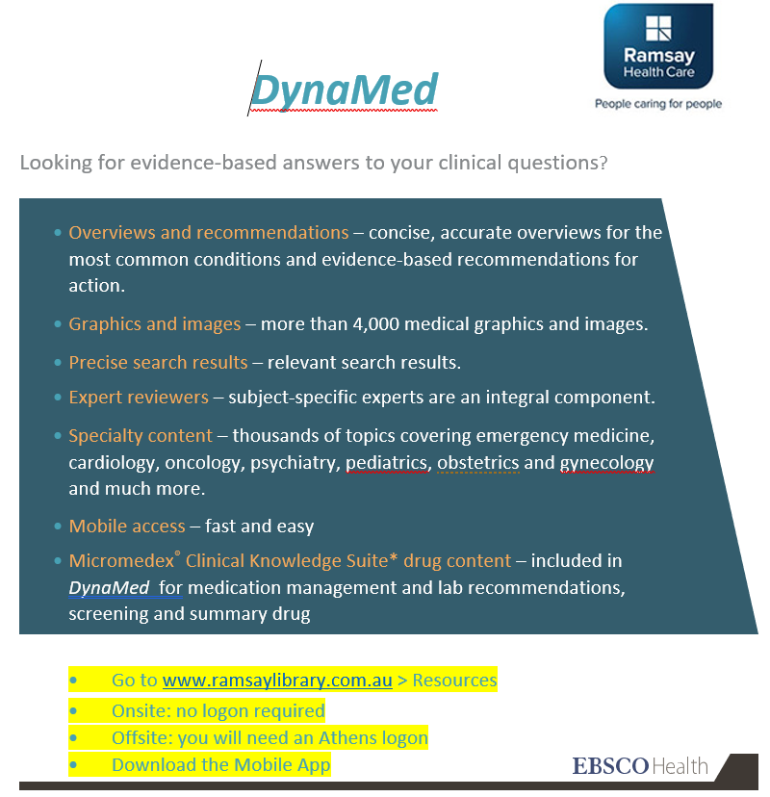
DynaMed is a clinical decision support tool, which combines the latest evidence, guidelines and expert opinion.
DynaMed can be downloaded to your mobile to be readily available at the point of care.

Slide 7
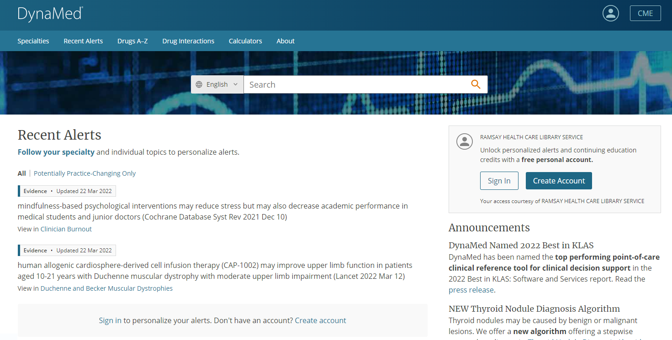

Slide 8
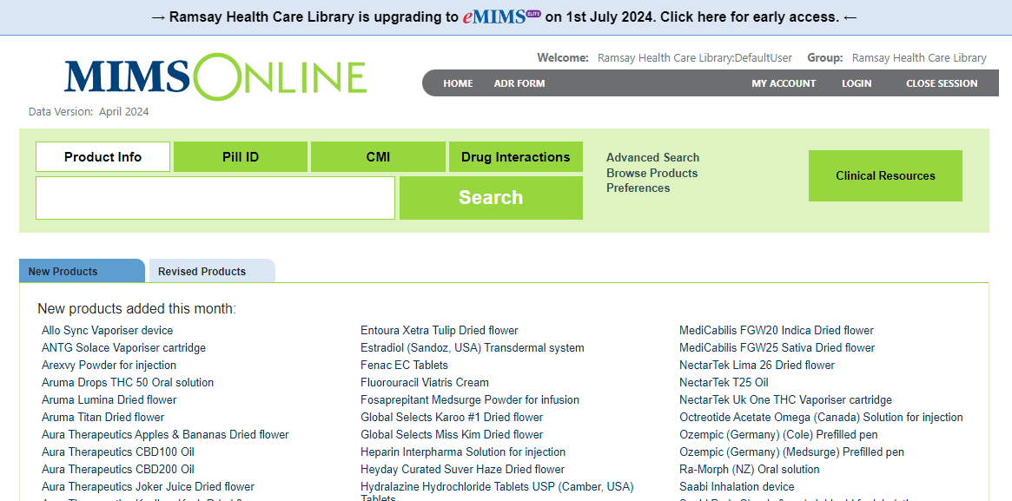
MIMS can be downloaded to your mobile to be readily available at the point of care.
See the Mobile Resources tab on the Library website for more information.
eMIMSelite will replace MIMSOnline 1st July 2024. Click on the link at the top of the page for early access.

Slide 9
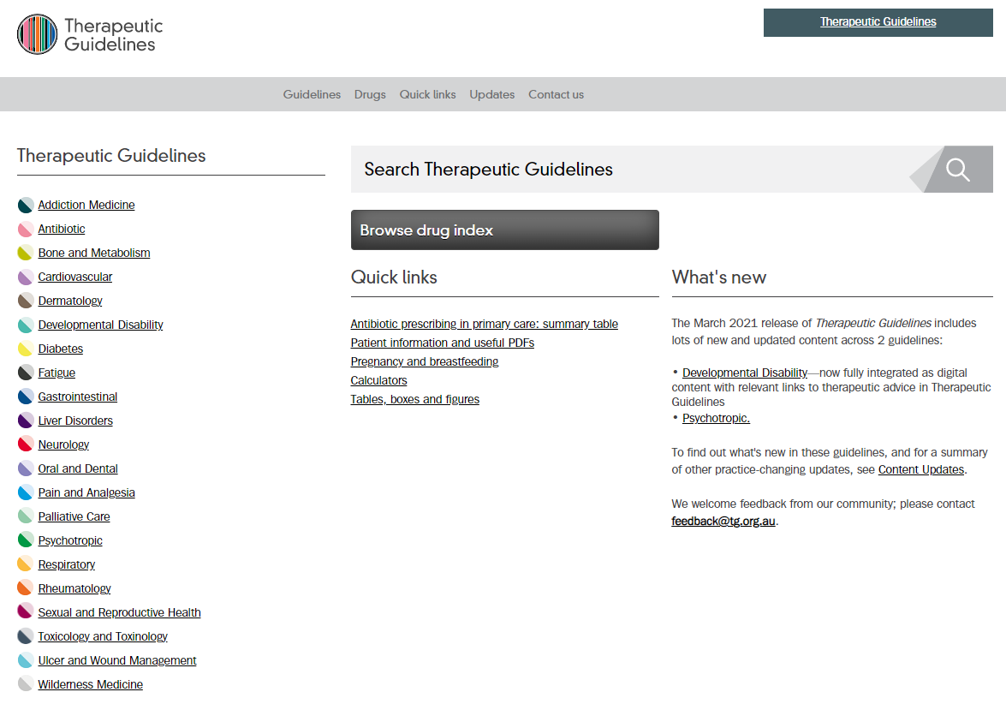
Therapeutic Guidelines: therapeutic guidelines, evidence-based, Australian (Medicines)
Offsite available using an Athens logon at:
https://tgldcdp.tg.org.au/etgAccess
There is no app. Save the link.

Slide 10
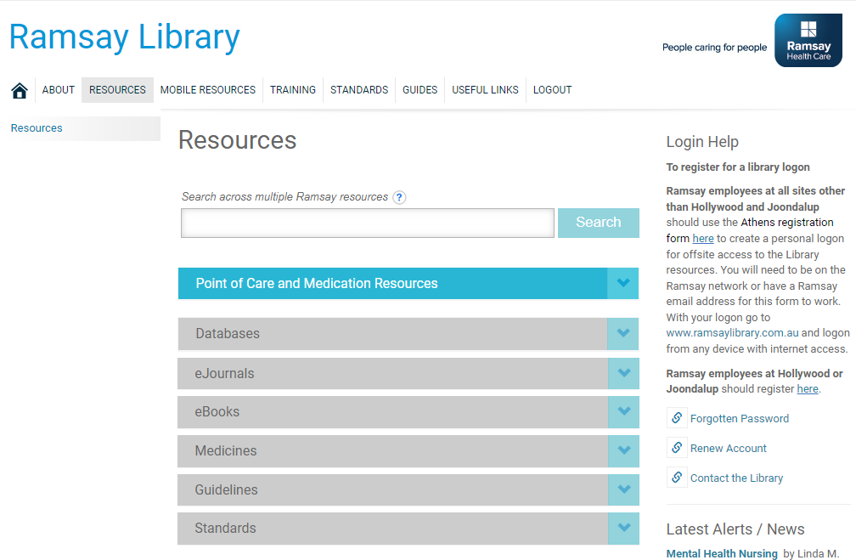
Ramsay National Library
https://www.ramsaylibrary.com.au
This is the main
Resources page
To Register for an
offsite Athens
logon, go to the
form for your
hospital at Login
Help.

Slide 11
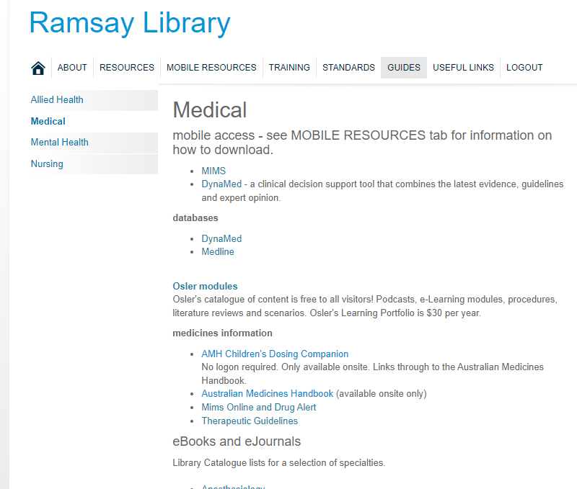
Download MIMS and DynaMed to
Your mobile. Go to the Mobile Resources tab for more information.
The GUIDES tab pulls together the Medical resources.

Slide 12
If you have any queries about the Library please contact:
Ramsay National Library
Jenny Cutting - National Librarian
Head Office, Learning & Organisational Development
library@ramsayhealth.com.au
Greenslopes Private Hospital Library
Sandra Villamil– HR Administration
villamils@ramsayhealth.com.au
07 3394 7162
Hollywood Private Hospital Library
Alison Dane- Librarian
library.hph@ramsayhealth.com.au
08 9346 6184
Joondalup Health Campus Clinical Library
Jeanette Bunting - Librarian
Melissa de Klerk - Library Technician
libraryenquiries@ramsayhealth.com.au
08 9400 9487

